Slide 1

IIoT Fundamentals and Applications Presented by SME Chapter 112

Slide 2

Who Am I?
My name is Adam Cook.
Studied Mechanical Engineering at Purdue University West Lafayette.
Chief Technical Officer of Alliedstrand in Chicago (we also have engineers in Dallas).
Chair of SME Chapter 112 (Northwest Indiana and Chicagoland). Check out sme112.org.
I work with embedded systems, robotics, automation systems and industrial software.
Contact my chapter at hello@sme112.org.

Slide 3
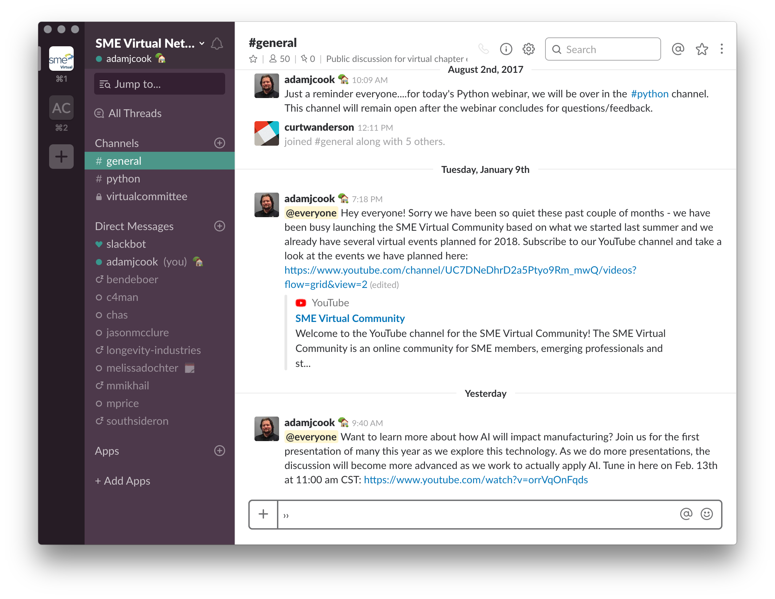

SME Virtual Network Slack
Are you an SME member? Do you want access to Slack? Fill out this short form: http://bit.ly/2BpjMiE

Slide 4
Agenda
Slides:
http://bit.ly/2HOb7GE
Part 1 - IIoT High-Level Tour and Engineering/Manufacturing Use Cases. Break
Part 2 – IIoT protocols, architectures, communications, IT/OT considerations and security.

Slide 5
What is IoT?
Slides:
http://bit.ly/2HOb7GE
Internet of Things (IoT) is (loosely) a broad term referring to a network of devices (or “things”) which can interoperate with the Internet.
IoT is sometimes called Internet of Everything (IoE).
A Thing is a physical object that can communicate via a network.
Things are decoupled from software applications/services in IoT.

Slide 6
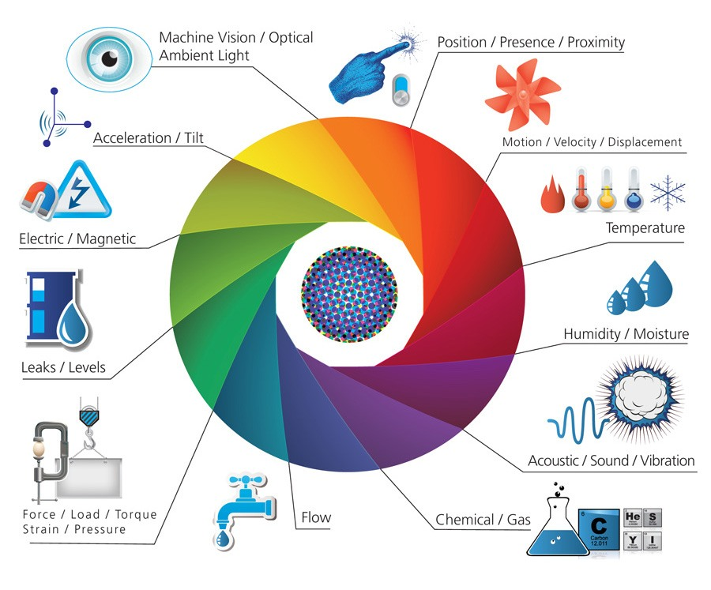
Sensors
Slides:
http://bit.ly/2HOb7GE
Source: http://bit.ly/2G7VEny
Notes:
Sensors sense and measure changes in the physical world.

Slide 7
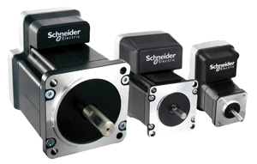
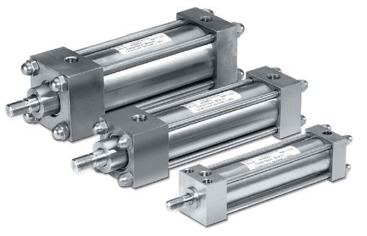
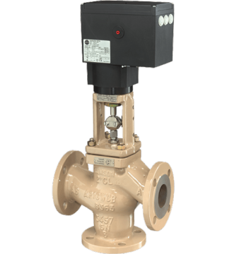
Actuators
Slides:
http://bit.ly/2HOb7GE
Cylinders
Motors
Servo Valve
Notes:
Actuators do useful work on the physical world.

Slide 8
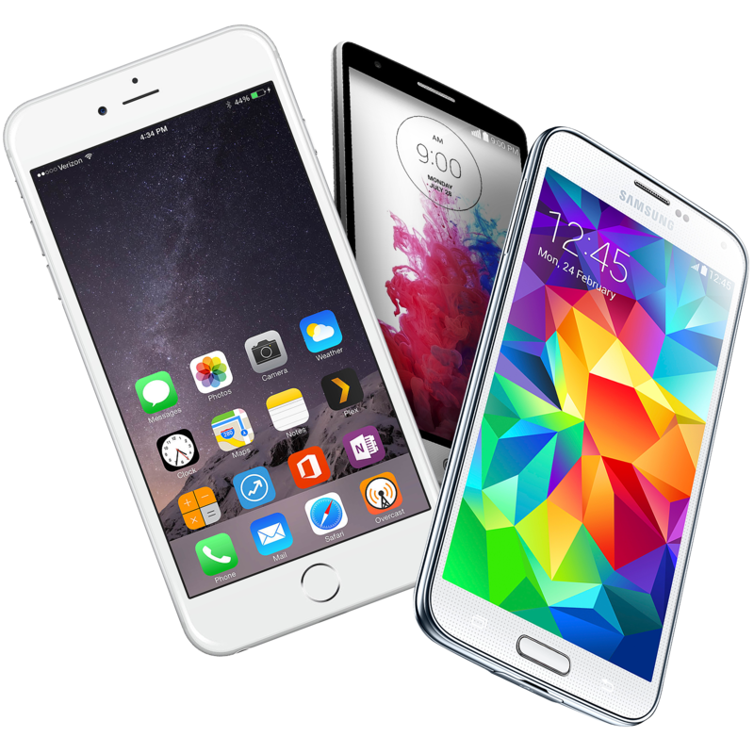
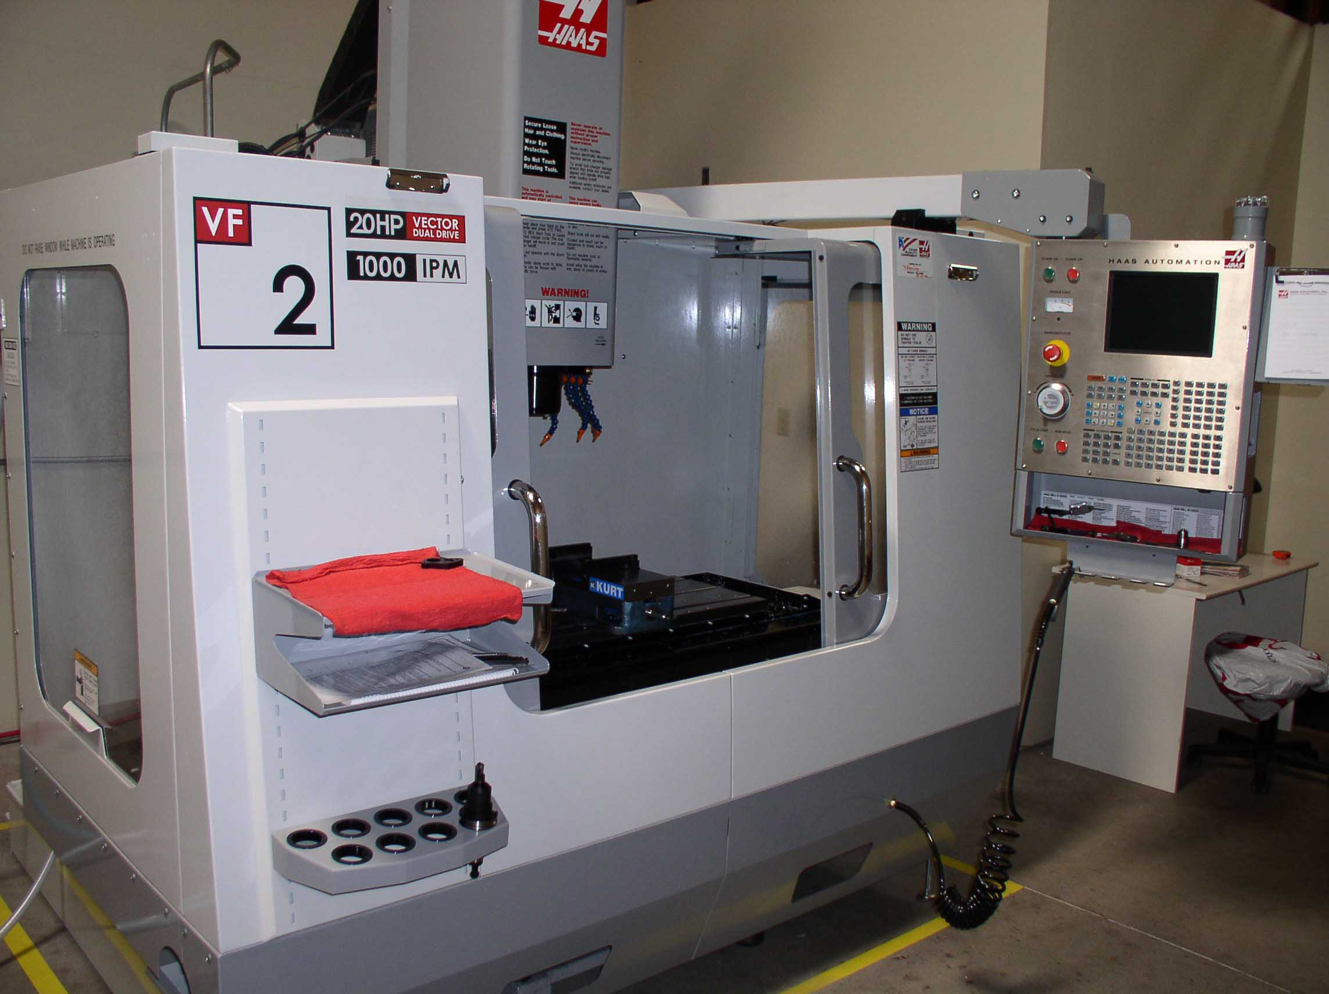
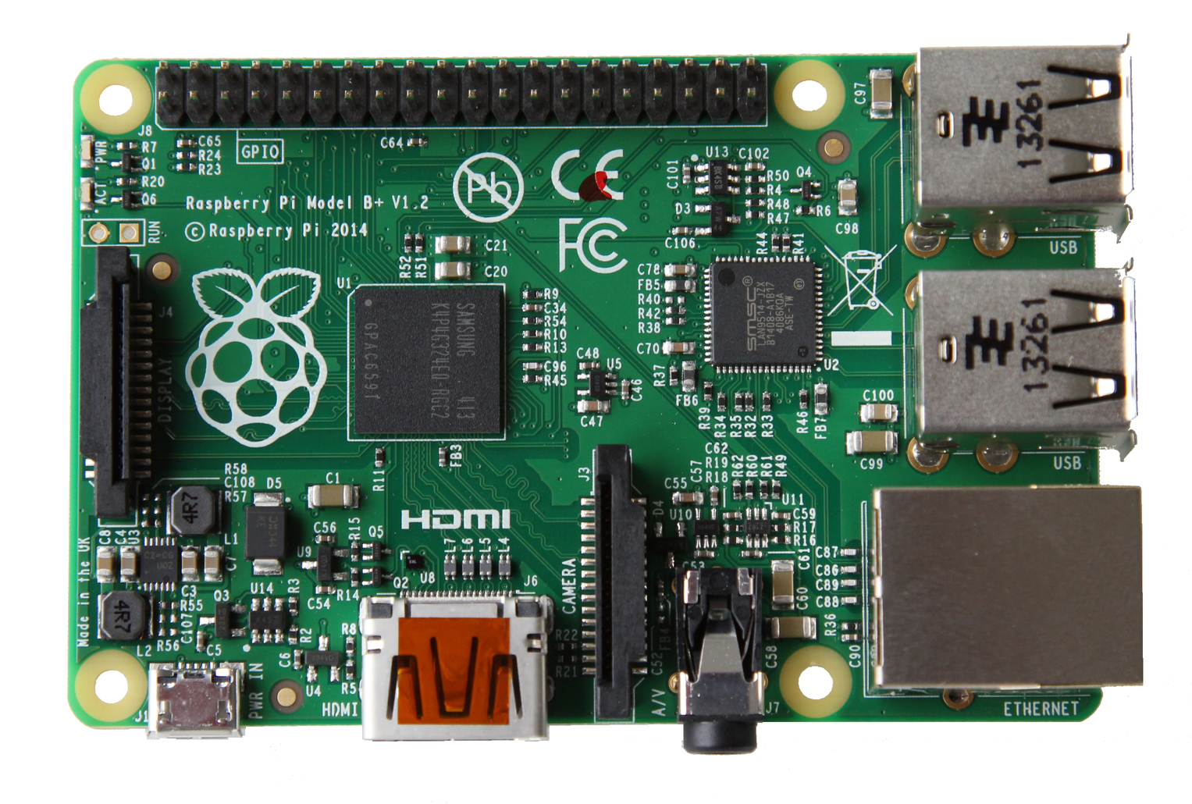
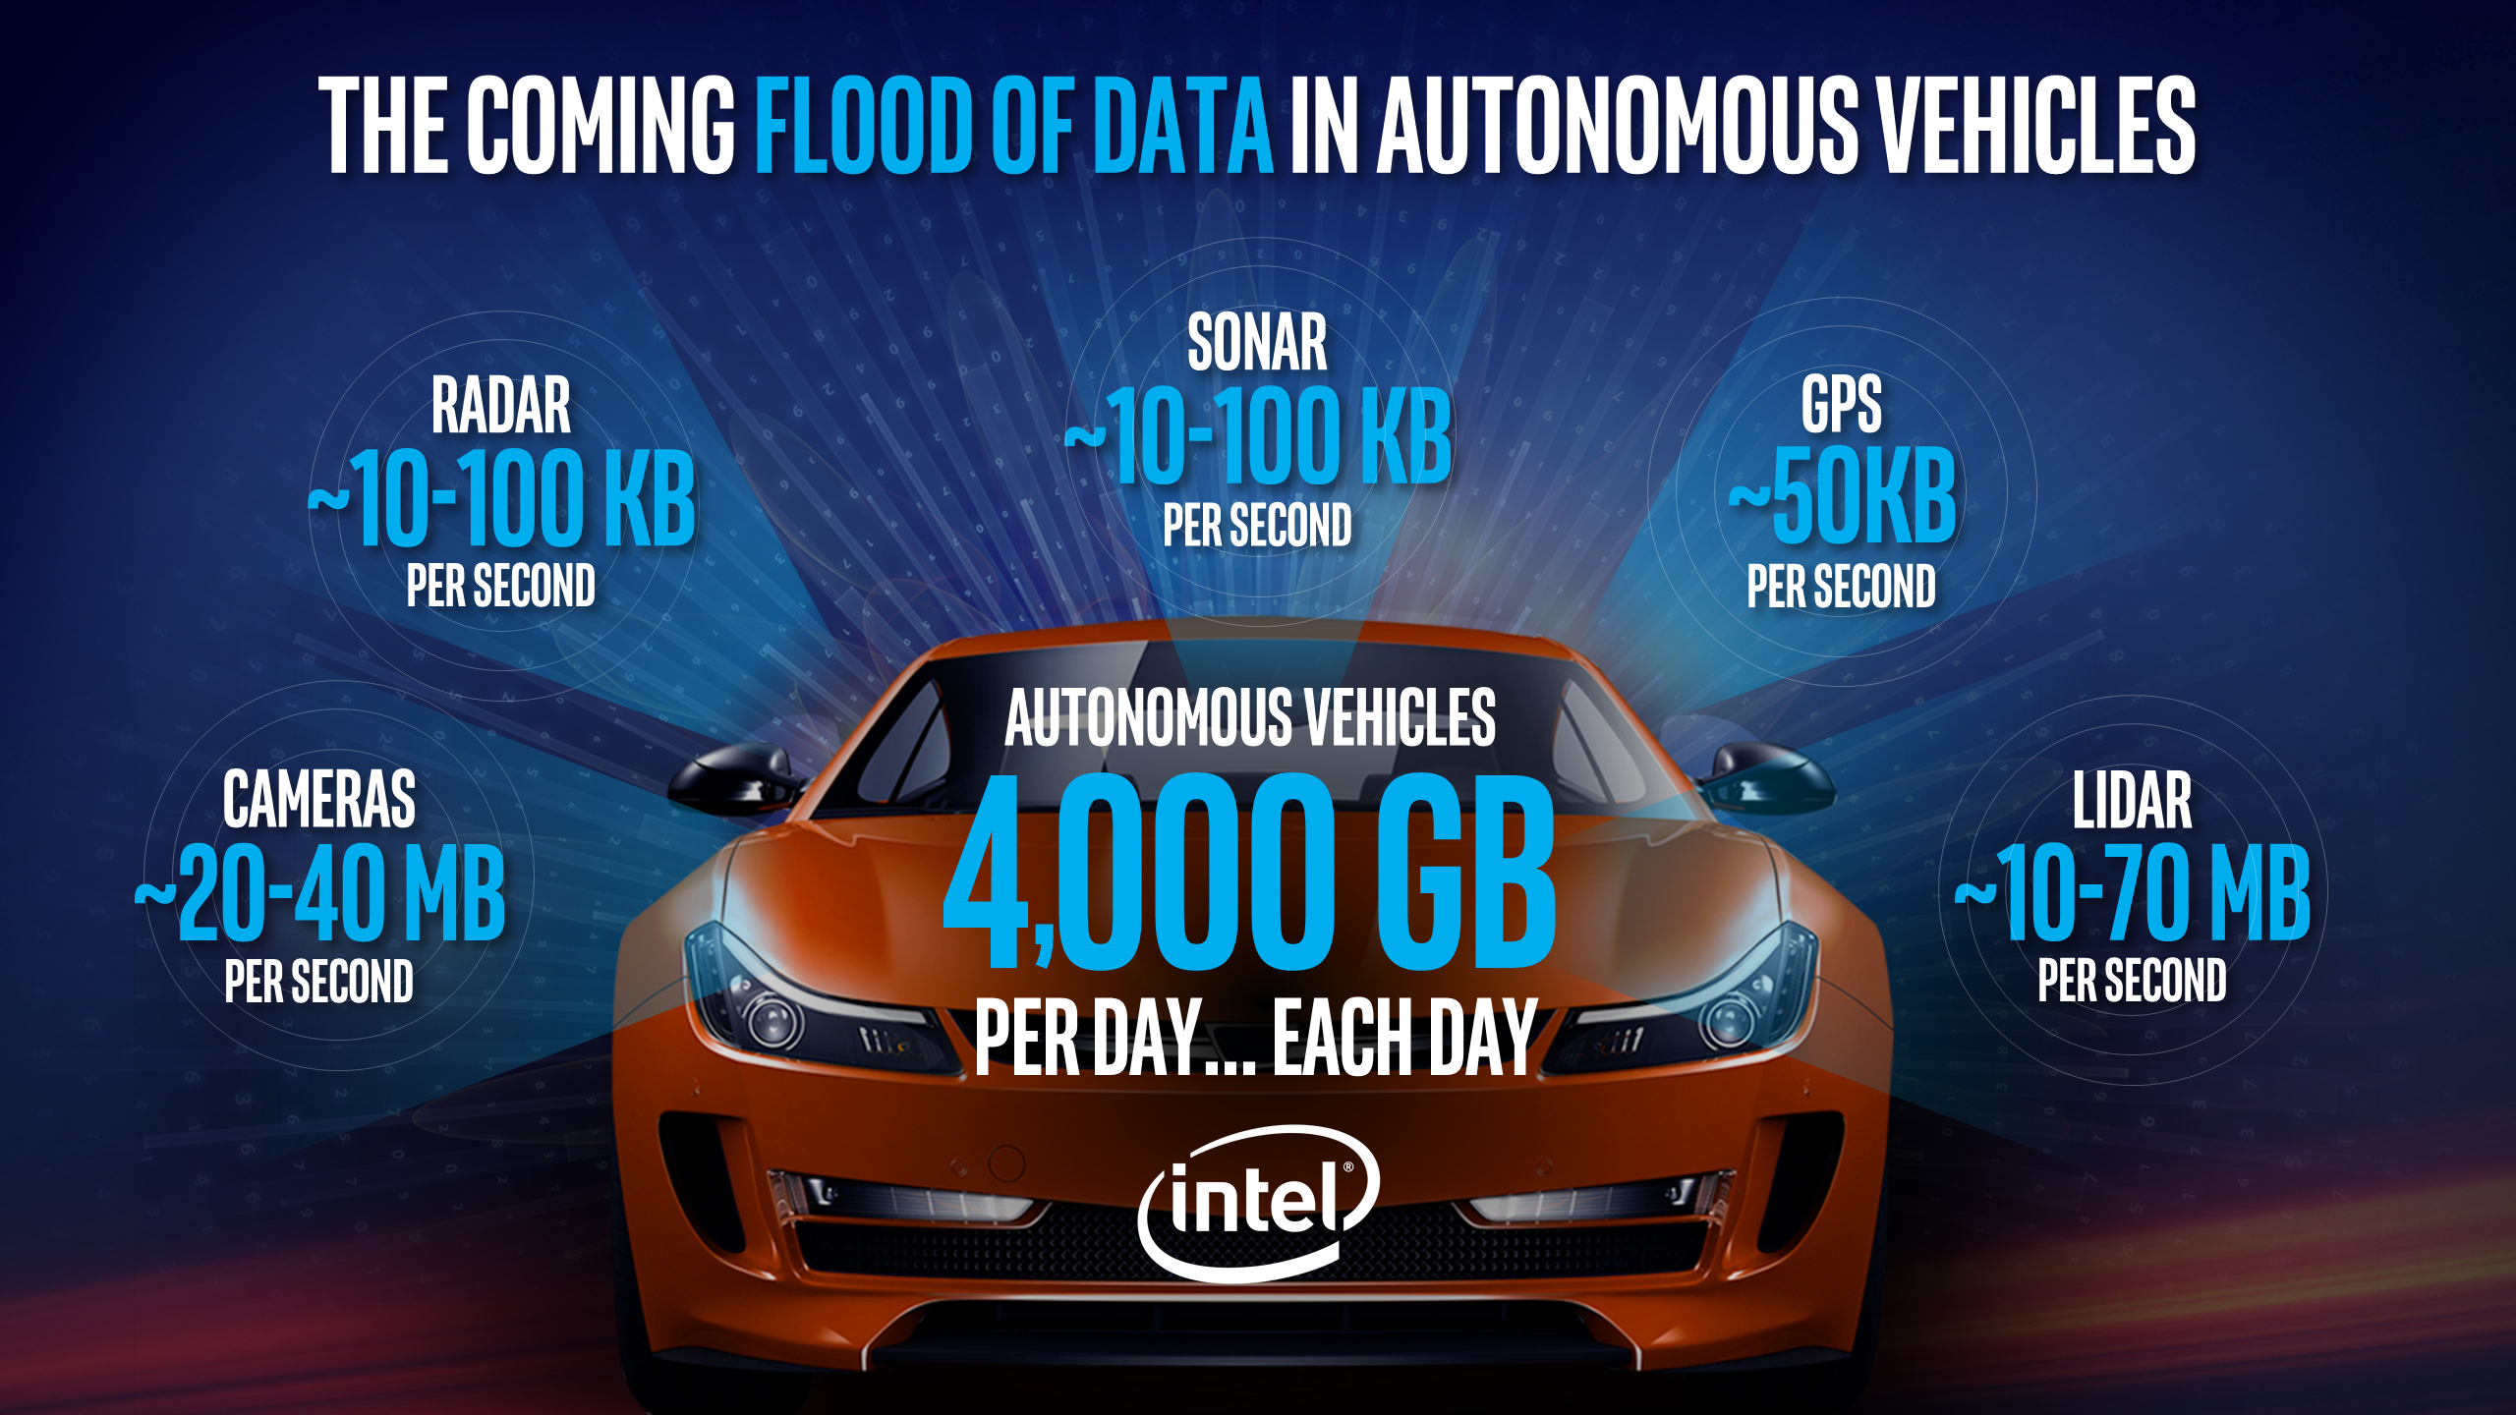
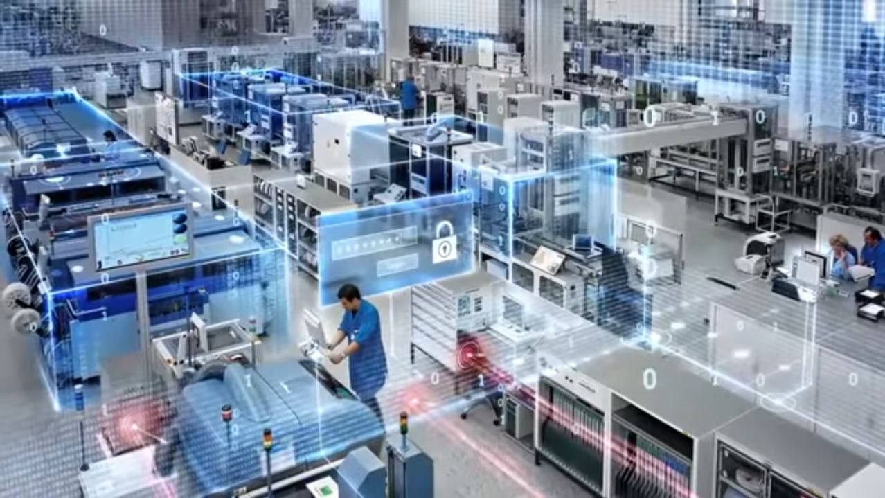
IoT connects…
Slides:
http://bit.ly/2HOb7GE
Things
Systems
Business Applications
ERP
CRM
PLM
Control Systems
People
Consumers
Partners
Decision Makers
Employees

Slide 9
Question
Slides:
http://bit.ly/2HOb7GE
Can you think of any commonly-used IoT devices?
Notes:
Mobile phone!

Slide 10
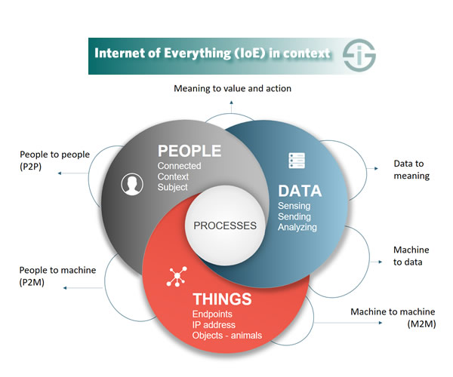
Connection Types
Slides:
http://bit.ly/2HOb7GE
Source: http://bit.ly/2otKGih

Slide 11

Coupled
Slides:
http://bit.ly/2HOb7GE
Relay
Early 1990s Home Automation System
What is the ROI on this?

Slide 12
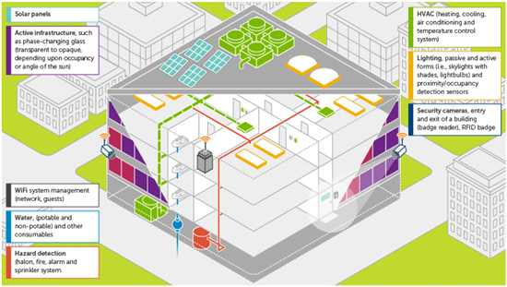
Decoupled
Slides:
http://bit.ly/2HOb7GE
Device Network
Machine Learning
Big Data
Cloud
Analytics
Source: http://dell.to/2u5mF6t
Probably an IoT Gateway here.

Slide 13
Decoupled
Slides:
http://bit.ly/2HOb7GE
To Device Network
Service Layer
Data Analytics
Machine Learning System(s)
Data Analytics
Analyze data from devices.
Training Data
Network Analytics
Analyze data from the network architecture used to connect devices.
Notes:
Data Analytics – analyze and extract value generated by devices and sensors.
Network Analytics – network packet metadata analysis (network problems, QoS), detection of cyber security attacks.

Slide 14
Latency
Slides:
http://bit.ly/2HOb7GE
High Latency
Cloud Computing Layer
Elastic compute, big data processing and data warehousing.
Fog Computing Layer IoT Gateway
Mist Computing Layer
Devices, sensors and actuators.
Low Latency
Notes:
Latency is a time interval between stimulation and response.

Slide 15
So what’s with the “Internet” in IoT?
Slides:
http://bit.ly/2HOb7GE
Internet
Decoupled
Global
Scalable (compute)
Notes:
Latency is a time interval between stimulation and response.

Slide 16
IoT Challenges
Slides:
http://bit.ly/2HOb7GE
Scale (Data and Network)
IoT has the possibility to scale to millions of devices.
Security/Privacy
Physical assets and IP can be at risk. This is a big one.
Interoperability
Devices and networks need to talk the same “language”.
Operational Issues IoT needs tight IT/OT coordination.
Implementation Commonality
IoT implements are largely made to order – particularly for the cloud services. Cost implications.

Slide 17
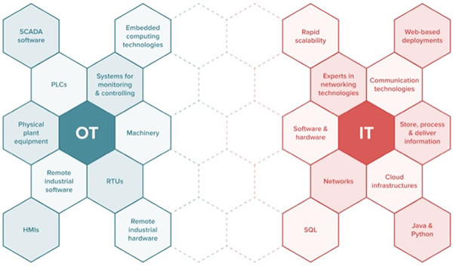
IT and OT
Slides:
http://bit.ly/2HOb7GE
Note this convergence.
Source: http://bit.ly/2GKH6bk
Notes:
IT – Information Technology – computers and supporting systems to store, retrieve, transmit and manipulate data.
IT is query based, non-real time and the data is largely at rest.
OT – Operational Technology – hardware (and hardware/software combination) used to detect and cause changes in physical processes.
OT is event based, real-time and the data is at motion.

Slide 18
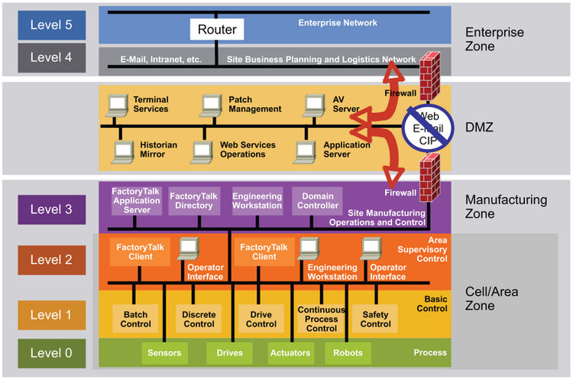
IT and OT Separation
Slides:
http://bit.ly/2HOb7GE
Phishing
Spear phishing
Purdue Model
USB/Physical equipment access
PLCs, HMIs
Notes:
Differences in priorities between IT and OT.
IT – Focused on protecting a company’s digital assets.
OT – Focused on high OEE, safety, and “always on” operations.
IT – Emphasizes strict network access control (authentication and access policies).
OT – Emphasizes strict physical access control.
IT – Device failure is expected and fail-over and elasticity are designed in.
OT – Device failure causes concrete economic harm to a company.
IT – Upgrades and patches are applied ASAP.
OT – Only during scheduled downtime.

Slide 19
Cyberattack Example Cases
Slides:
http://bit.ly/2HOb7GE
December 2015 Ukraine power grid cyberattack
German steel mill cyberattack
Saudi Aramco and Qatar RasGas cyberattack (2012)
WannaCry ransomware attack
Notes:
Ukraine Power Grid Cyberattack – Spear-fishing
Saudi Aramco – business layer was at risk, but ICS layer was budgeted to be “secure”. Virus entered the business layer and infected security appliances and critical workstations.
WannaCry – exploited holes in old versions of the Windows operating system to infect systems. The UK’s National Health Service (NHS) was deeply effected.

Slide 20
So what is IIoT?
Slides:
http://bit.ly/2HOb7GE
IIoT stands for Industrial Internet of Things.
IIoT is sometimes called Industrial Internet.
IIoT is really a subcategory of IoT. Many of the technologies are the same (but not all) but it focuses on “industrial” use cases.
The business case for IIoT is increasing efficiency and safety while reducing costs.
IoT
IIoT
Notes:
Industrial use cases could include smart factories, transportation, logistics, building automation and smart cities.

Slide 21
What is Industry 4.0?
Slides:
http://bit.ly/2HOb7GE
Sometimes will hear that Industry 4.0 and IIoT are the same.
Technically, they are not.
Industry 4.0 (Industrie 4.0) is/was a German government program in digitizing manufacturing.
Industry 4.0 is also called the 4th Industrial Revolution.
Cyber Physical Systems, IIoT, advanced data analytics and machine learning.

Slide 22
IIoT Reference Models/Architectures
Slides:
http://bit.ly/2HOb7GE
Purdue Enterprise Reference Architecture
Industrial Internet Reference Architecture (IIRA) by Industrial Internet Consortium (IIC).
Notes:
Purdue Model – segments devices and equipment into hierarchical functions.
IIRA – platform developed to drive interoperability, map applicable technologies and guide standards development.

Slide 23
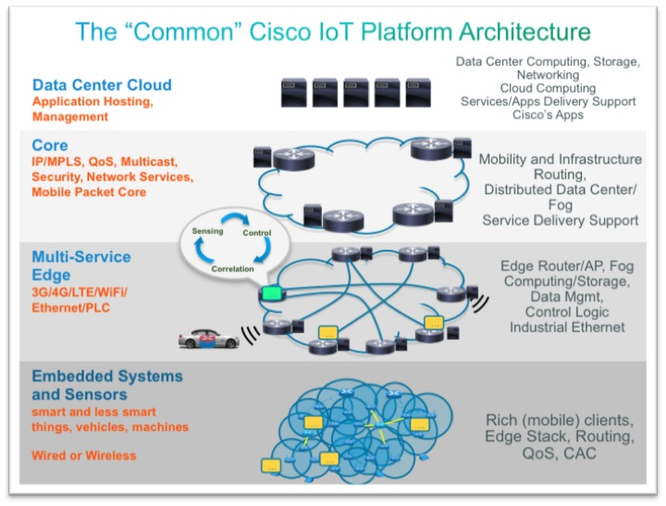
IIoT Reference Models/Architectures
Slides:
http://bit.ly/2HOb7GE
Source: http://bit.ly/2zpBpeN
Notes:
Purdue Model – segments devices and equipment into hierarchical functions.
IIRA – platform developed to drive interoperability, map applicable technologies and guide standards development.

Slide 24
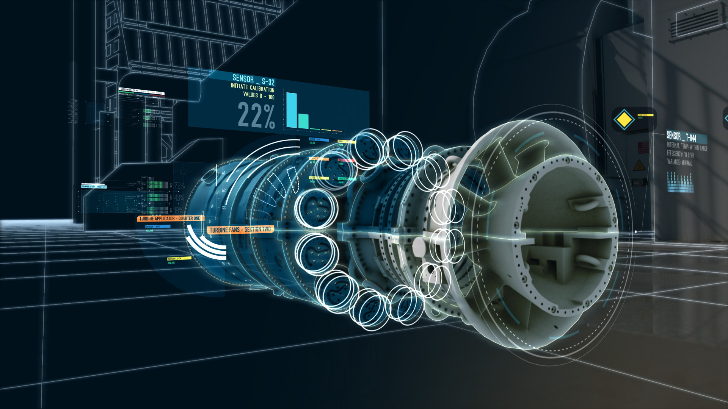
Use Case – Digital Twin
Slides:
http://bit.ly/2HOb7GE
3D Models
Physics-Based Models
Sensor Data
Human Knowledge
Historical Data
Digital Simulations
Source: http://bit.ly/2pqVZbo
Data Analytics/Big Data
Note: There is something like 20,000 sensors on a jet engine!
Machine Learning
Notes:
Rolls-Royce has a system for their engines as well.
Other popular examples of digital twins include Aircraft Engines, Wind Turbines, Offshore Rigs, Locomotives, Buildings and Whole Cities.

Slide 25
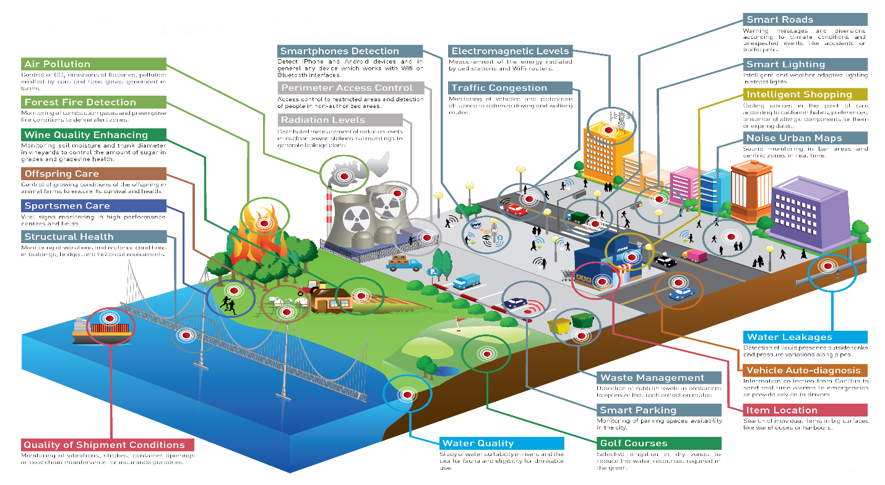
Use Case – Smart City/Smart Building
Slides:
http://bit.ly/2HOb7GE
Smart phones, smart meters, networks of sensors and RFIDs.
LPWAN
Check out UI Labs’ City Tech iniatives.

Slide 26
Use Case – Building Automation
Slides:
http://bit.ly/2HOb7GE
Can also be tied to larger “smart cities” effort.

Slide 27
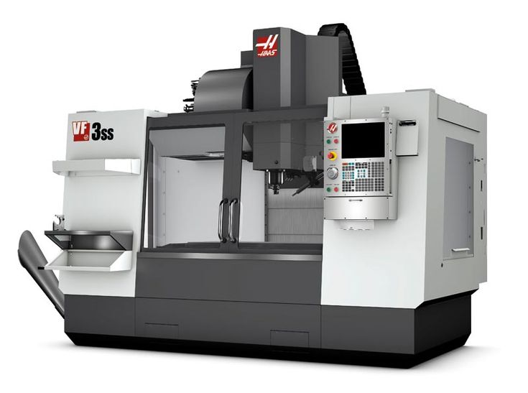
Use Case – Predictive Maintenance
Slides:
http://bit.ly/2HOb7GE
Using historical operational data to determine failure windows prior to them occurring.
Spindle bearing heat and vibration sensors
Heat sensors on ball screws
Machine bed vibration sensors
Coolant filter pressure sensors
What else can this data be used for?

Slide 28

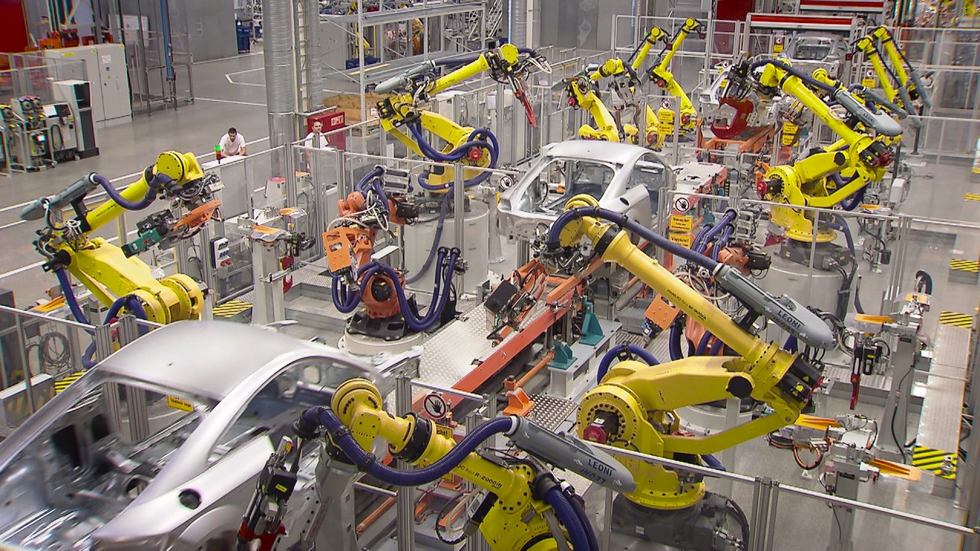
Use Case – (Smart) Factory Automation
Slides:
http://bit.ly/2HOb7GE
Cloud
Robot-to-robot.
Factory-to-cloud.
Factory-to-factory.
Finished product-to-factory.

Slide 29
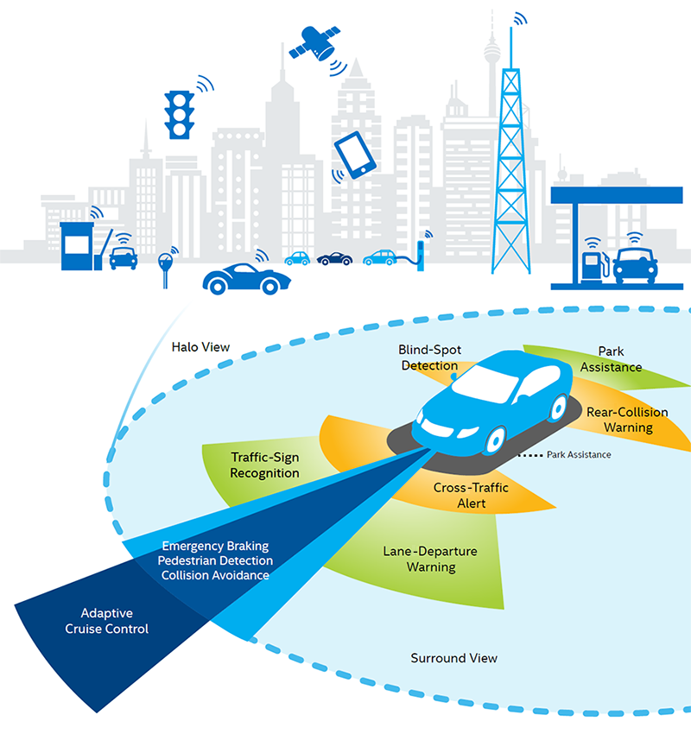
Use Case – Autonomous Vehicles
Slides:
http://bit.ly/2HOb7GE
Cloud
Vehicle-to-vehicle.
Vehicle-to-cloud.
Vehicle-to-smart city.
CANbus
Source: http://intel.ly/2pr0xhX
Notes:
Network in most vehicles is a communication bus know as CANbus. This allows devices (usually internal to the vehicle) to communication with each other without a host computer.

Slide 30
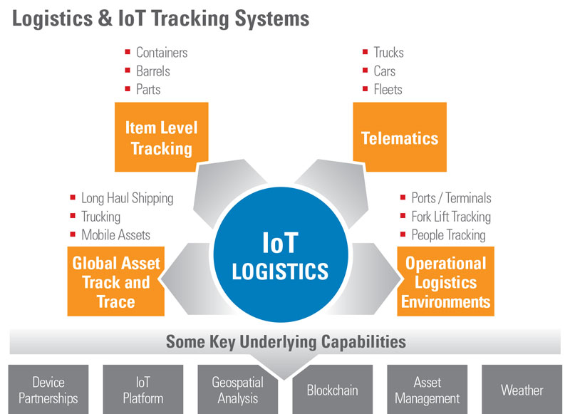
Use Case – Asset Tracking
Slides:
http://bit.ly/2HOb7GE
Source: http://bit.ly/2HPC64z

Slide 31
What about small/medium businesses?
Slides:
http://bit.ly/2HOb7GE
Favor incremental steps to IIoT adoption over large projects.
IIoT is not magic. It is most useful when finding that “last mile” of efficiency.
Having the IT and OT personnel and expertise is critical.
Security needs to be budgeted in and enforced enterprise-wise. In a lot of ways, the attack surface is larger in IIoT.
Beware of legacy equipment challenges.
Careful! It can transform your enterprise (hopefully, for the better).

Slide 32
Break
Slides:
http://bit.ly/2HOb7GE
Next up. We take a deeper technical dive into IoT/IIoT.
6LoWPAN: http://bit.ly/2GQSJ0E

Slide 33
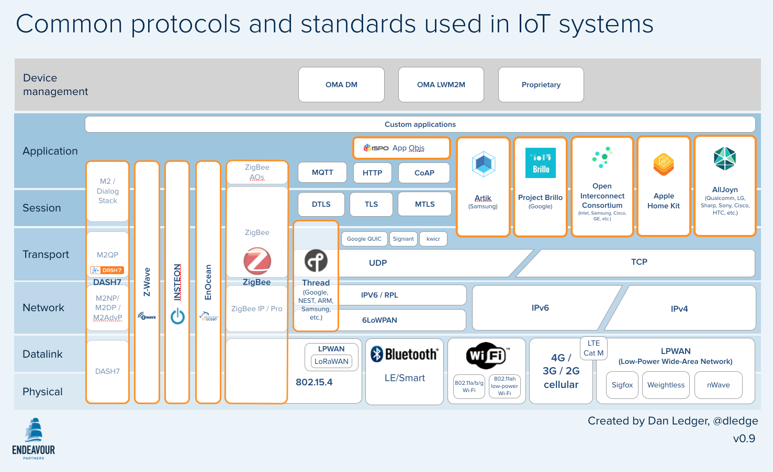
IoT Stack Overview
Slides:
http://bit.ly/2HOb7GE
Layers based on the OSI Model
Layers based on the OSI Model
We will work up this way.
Theoretically, you can pick and choose technologies from each layer independently from one another.
Source: http://bit.ly/2G8zbHa
Notes:
For example, you can “choose” UDP or TCP for the transport layer, but it is usually chosen for you by the application layer.
Some other models (besides the OSI Model), wrap up the “Session” layer into the “Application” layer.
OSI model is a little bit of a stretch for IoT.

Slide 34
IoT Stack Overview + Some More Industrial
Slides:
http://bit.ly/2HOb7GE
MTConnect
OPC-UA
Ethernet
Source: http://bit.ly/2G8zbHa

Slide 35
Physical and Datalink Layers
Slides:
http://bit.ly/2HOb7GE
Contains embedded systems and sensors, but, more importantly, the standards which will connect to the Internet.
GSM, 3G, LTE, 4G, 5G
Ethernet
WiFi (802.11b, g, n)
LPWAN

Slide 36
Physical/Datalink Layers - LPWAN
Slides:
http://bit.ly/2HOb7GE
WLAN – Wireless Local Area Network (WiFi)
WWAN – Wireless Wide Area Network (Cellular)
LPWAN – Low-Power Wide Area Network
LPWANs are great for:
Filling gaps between WLAN and WWAN.
Devices that need great battery life.
Transmission distance over 15 km.
Capable of outdoor use.
Low-cost.

Slide 37
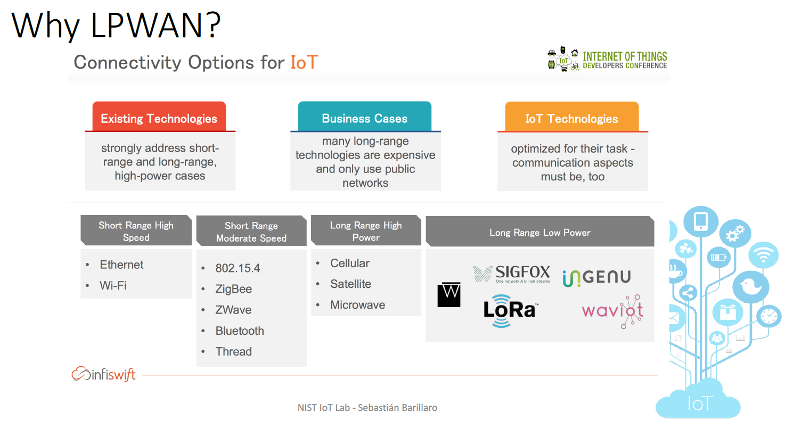
Other LPWAN Technologies
Slides:
http://bit.ly/2HOb7GE
aka WWAN
aka LPWAN
aka WLAN
Source: http://bit.ly/2IE7JPG
aka LoRaWAN

Slide 38
Network Layer
Slides:
http://bit.ly/2HOb7GE
Internet is here.
Provides a connection between networks and a connection between physical layers (to each other or to cloud services).
Unique identifier called an IP Address is here.
IPv4
RPL
IPv6

Slide 39
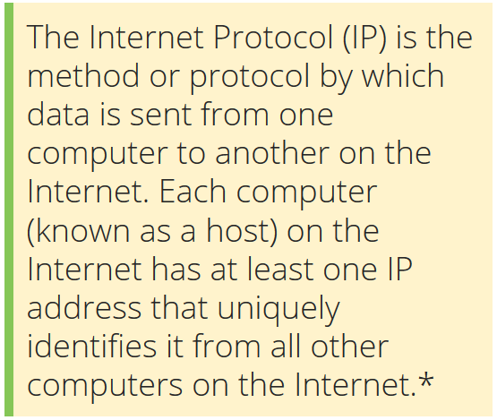
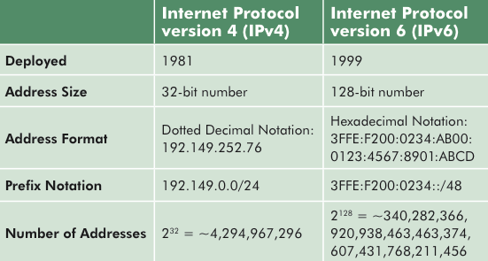
Network Layer – IPv4 vs. IPv6
Slides:
http://bit.ly/2HOb7GE
IPv6 Advantages:
Larger address space.
Better built-in security.
Harmonizes IoT datalink layer.
Source: http://bit.ly/2IATz21

Slide 40



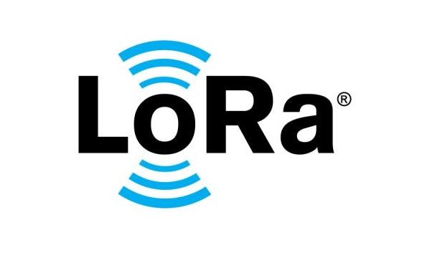
Network Layer – IPv6
Slides:
http://bit.ly/2HOb7GE
IPv6 creates a common network layer for these technologies.

Slide 41
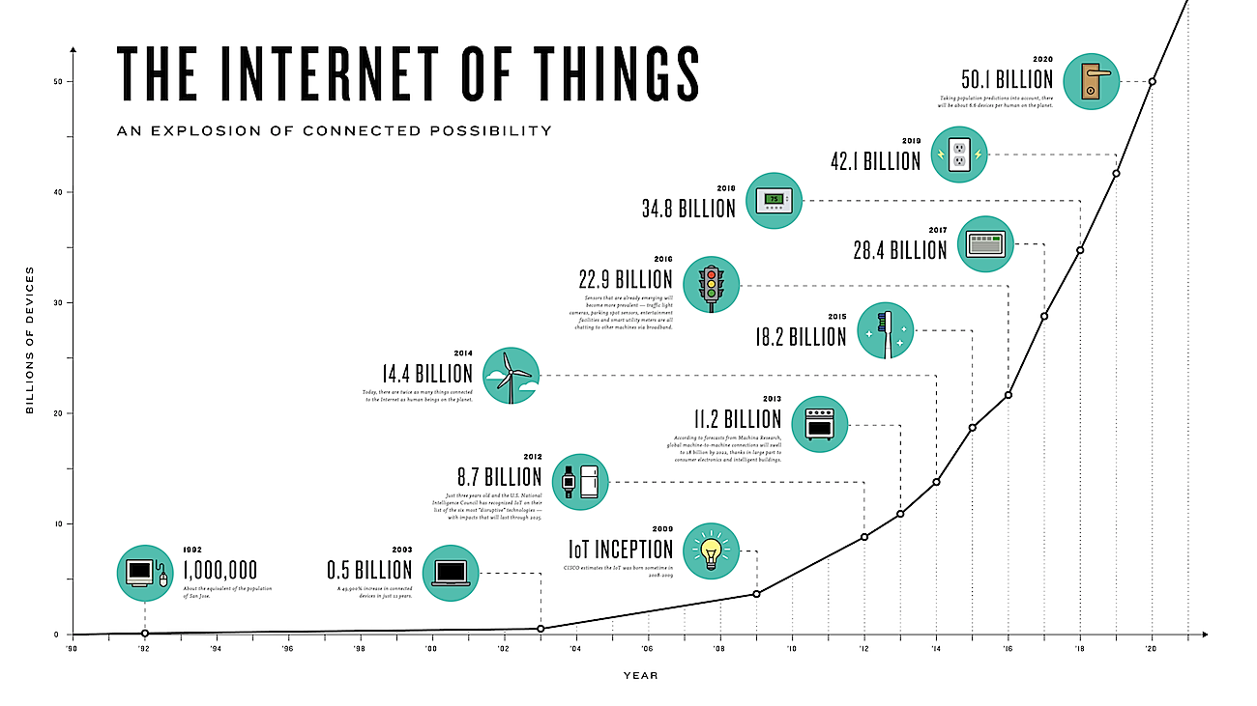
Network Layer – IPv4 Address Exhaustion
Slides:
http://bit.ly/2HOb7GE
IPv4 Exhaustion Point
Source: http://bit.ly/2GLxey5

Slide 42
Transport Layer
Slides:
http://bit.ly/2HOb7GE
TCP and UDP are here.
Data stream handling.
TCP – Transmission Control Protocol
UDP – User Datagram Protocol
UDP is popular for IoT use. TCP is popular for IIoT. These are not hard rules.

Slide 43
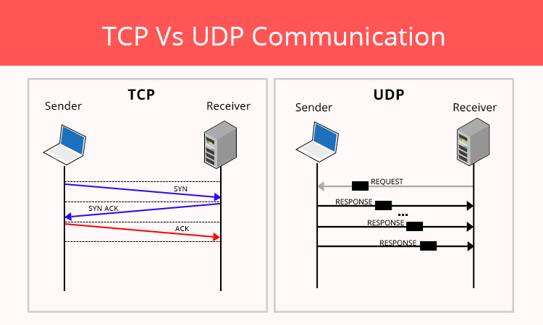
TCP vs. UDP
Slides:
http://bit.ly/2HOb7GE
Source: http://bit.ly/2FNTfPz
Notes:
TCP – suitable for applications that require high reliability, but transmission time and battery life is less critical. Examples include web browsing and e-mail.
UDP – suitable for applications that need fast and efficient transmission, but high reliability takes a back seat. Simpler protocol and therefore it is easier on the battery life. Examples include music streaming, games, VoIP.

Slide 44
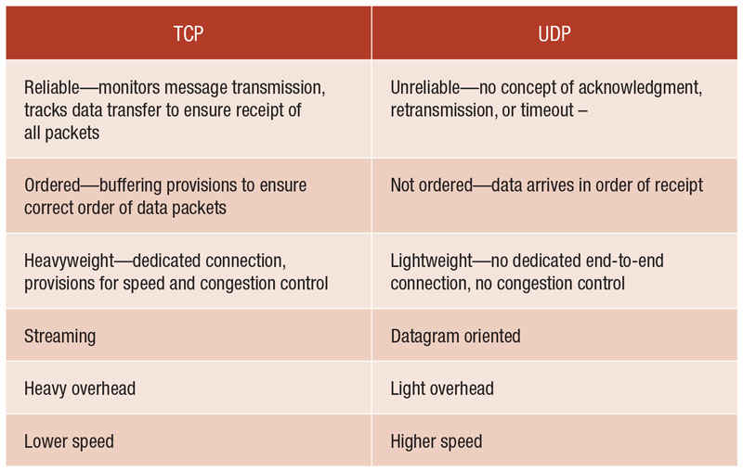
TCP vs. UDP
Slides:
http://bit.ly/2HOb7GE
Source: http://bit.ly/2DHqwG4
Notes:
TCP – suitable for applications that require high reliability, but transmission time and battery life is less critical. Examples include web browsing and e-mail.
UDP – suitable for applications that need fast and efficient transmission, but high reliability takes a back seat. Simpler protocol and therefore it is easier on the battery life. Examples include music streaming, games, VoIP.

Slide 45
Application Layer
Slides:
http://bit.ly/2HOb7GE
Contains value-added applications, communications protocols and interface methods for a network.
Does not really say anything about data formats used. It is common for large sensor networks to be involved in unstructured data transfer.
MTConnect
OPC-UA
HTTP
MQTT

Slide 46
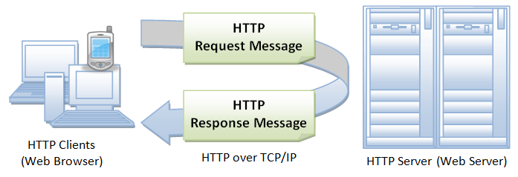
Application Layer - HTTP
Slides:
http://bit.ly/2HOb7GE

Slide 47
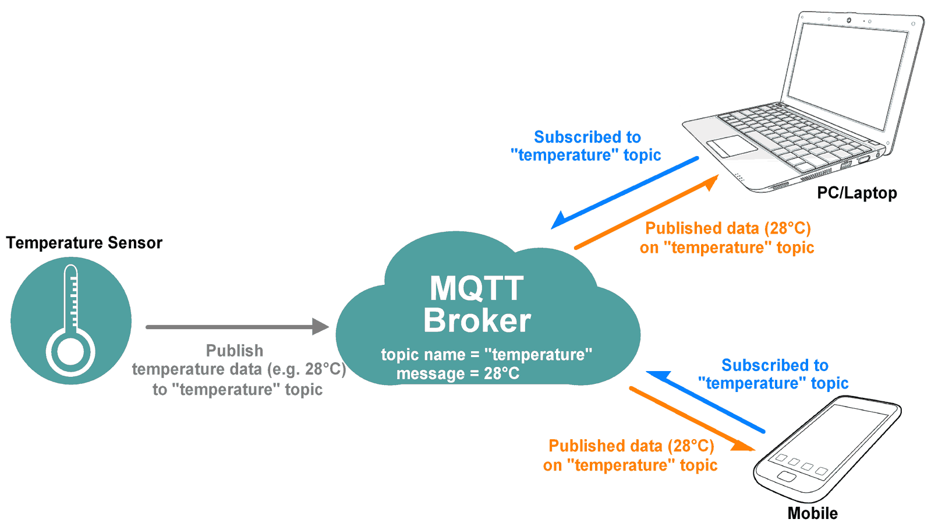

Application Layer - MQTT*
Slides:
http://bit.ly/2HOb7GE
Subscribers
Publisher
Source: http://bit.ly/2GLXCrG
Notes:
Means that this topic will be addressed in detail within its own webinar or part of a workshop.

Slide 48
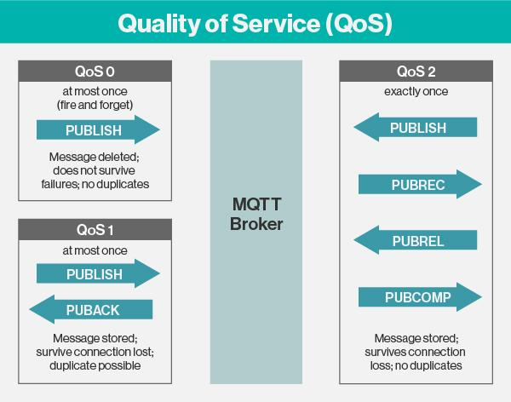
Application Layer – MQTT QoS
Slides:
http://bit.ly/2HOb7GE
Source: http://bit.ly/2FW4iSO
Notes:
Means that this topic will be addressed in detail within its own webinar or part of a workshop.
PUBLISH – Publish message.
PUBACK – Publish acknowledgement.
PUBREC – Publish received.
PUBREL – Publish release.
PUBCOMP – Publish complete.

Slide 49
Web Stack vs. IoT Stack
Slides:
http://bit.ly/2HOb7GE
HTML
Messages
HTTP
MQTT
TLS
TLS
Web
IoT
TCP
TCP
IPv6
6LoWPAN

Slide 50
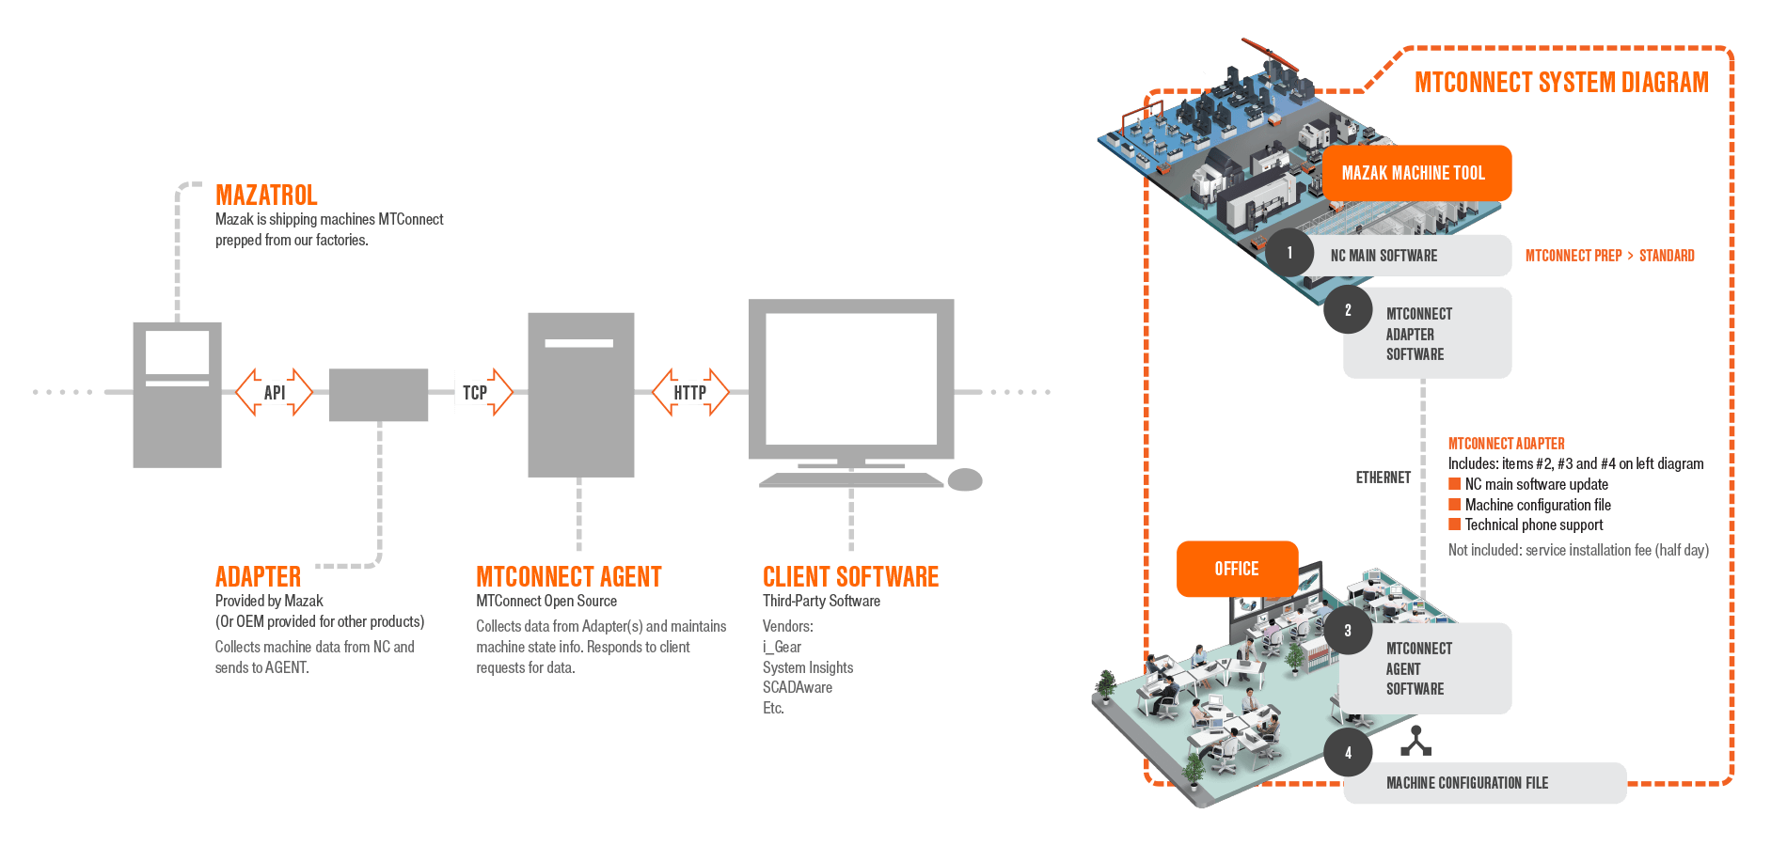

MTConnect*
Slides:
http://bit.ly/2HOb7GE
XML data format
Provides REST interface
Source: http://bit.ly/2G4QMjh
Notes:
Technical standard to retrieve process information from NC machine tools.

Slide 51
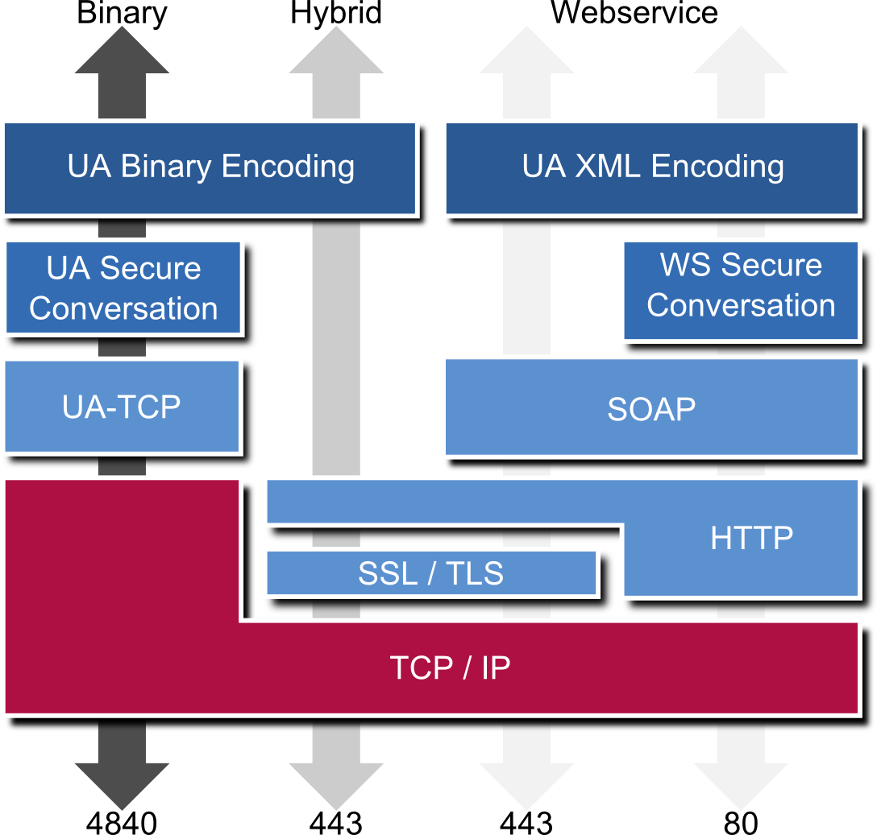
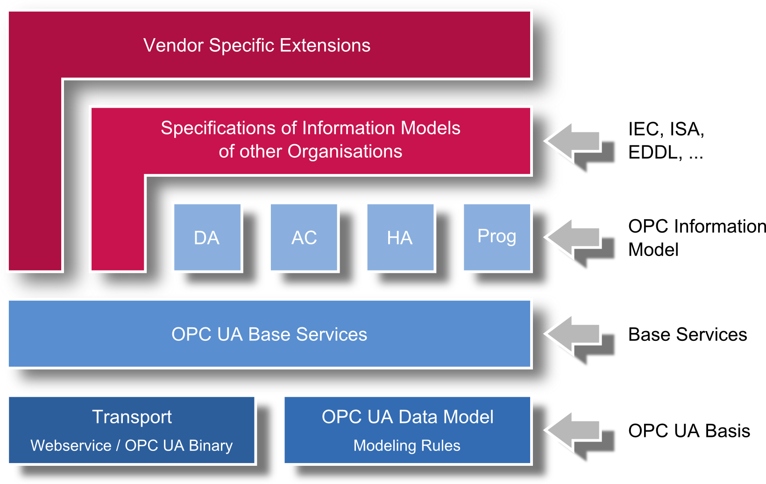

OPC-UA*
Slides:
http://bit.ly/2HOb7GE
Image credit ascolab
Notes:
Machine-to-machine communication protocol for industrial automation.
OPC-UA is the successor to OPC Classic.

Slide 52






Other Automation Protocols*
Slides:
http://bit.ly/2HOb7GE
CANbus

Slide 53
Upcoming Webinars
Slides:
http://bit.ly/2HOb7GE
We will dive down to the code level with these technologies:

Slide 54
Thank you!
Slides:
http://bit.ly/2HOb7GE
Want to learn more about
?
Check out sme.org
Questions? Ask in the Live Chat or Slack or check the feedback link in the description!

